Slide 1









Socios Clave
Actividades Clave
Propuesta de Valor
Relación con Clientes
Segmento de Clientes
Recursos Clave
Canales
Estructura de Costes
Fuentes de Ingresos

Slide 3
Premast Business Model Canvas
Designed for:
Designed by:
Who are our Key Partners?
Who are our key suppliers?
Which Key Resources are we acquiring from partners?
Which Key Activities do partners perform?
motivations for partnerships:
  Optimization and economy
  Reduction of risk and uncertainty
  Acquisition of particular resources and activities
What Key Activities do our Value Propositions require?
Our Distribution Channels?
Customer Relationships?
Revenue streams?
What value do we deliver to the customer?
Which one of our customer’s problems are we helping to solve?
What bundles of products and services are we offering to each Customer Segment?
Which customer needs are we satisfying?
What type of relationship does each of our Customer Segments expect us to establish and maintain with them?
Which ones have we established?
How are they integrated with the rest of our business model?
How costly are they?
For whom are we creating value?
Who are our most important customers?
  Mass Market
  Niche Market
  Segmented
  Diversified
  Multi-sided Platform
What Key Resources do our Value Propositions require?
Our Distribution Channels? Customer Relationships? Revenue Streams?
Through which Channels do our Customer Segments want to be reached?
How are we reaching them now?
How are our Channels integrated?
Which ones work best?
Which ones are most cost-efficient?
What are the most important costs inherent in our business model?
Which Key Resources are most expensive?
Which Key Activities are most expensive?
For what value are our customers really willing to pay?
For what do they currently pay?
How are they currently paying?
How would they prefer to pay?

Slide 4
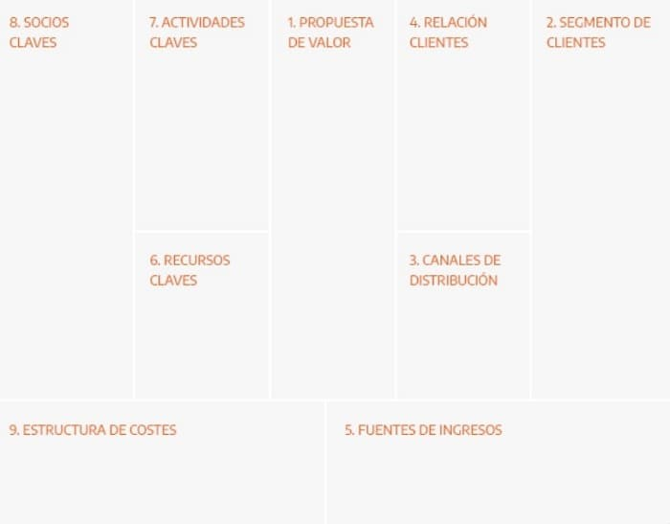
EJEMPLO 1

Slide 5
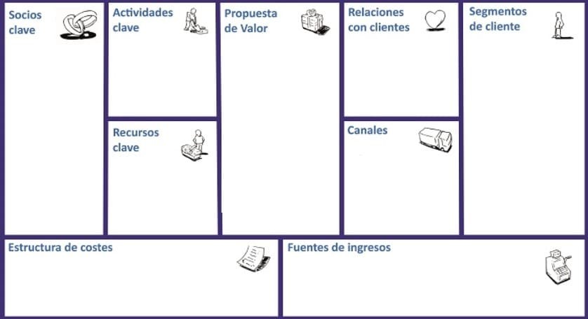
EJEMPLO 2

Slide 6

ICONOS

Slide 7









































Slide 8














